Slide 1
Predictive Model For Determining The Driver Fault In A Car Accident
Team 4: Jiahao (Michael) Zhang, Zhiyu (Eric) Chen, Avi Dhruva, Jonathan Ham, Brandon Herold

Slide 2
Table of contents
01
02
Business Question
Dataset Overview
03
04
Data Preprocessing
Descriptive Analysis
05
06
Prediction Models
Implications/Applications

Slide 3
01
Business Problem

Slide 4

Problem
By analyzing multifaceted factors—ranging from environmental conditions to specific incident details—we aim to unveil the nuanced influences on accident causality. As a result, we aim to develop a predictive model that enhances the accuracy of fault determination post-incident.

Slide 5
Why is this problem important?
~6 million
~40,000
~280 million
Crashes in 2023
Fatalities in 2023
Cars on the road in America
Source From NHTSA
National Highway Traffic Safety Administration

Slide 6
Who cares?
Law Enforcement
General Public
Insurance Companies
1
2
3
Police are often responsible for investigating car crashes
Cars are by far the most common way Americans use to commute
Relies on fault attribution to assess liability, process claims, and ensure fair compensation

Slide 7
02
Dataset Overview

Slide 8
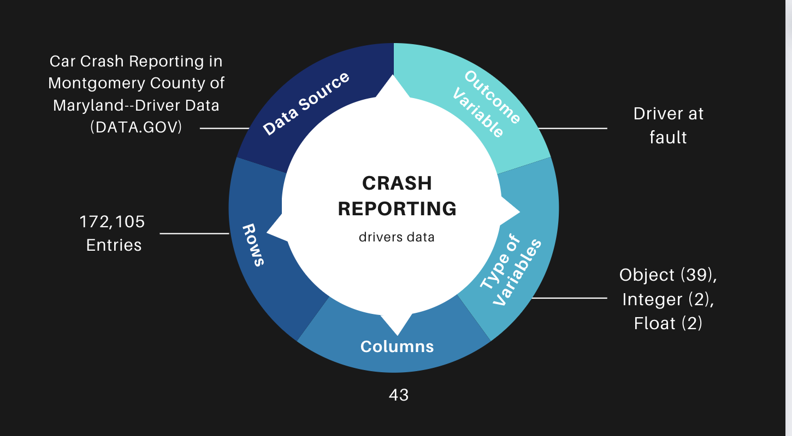

Slide 9
03
Data Preprocessing

Slide 10
Data Cleaning
Unnecessary Fields
Missing Values
Logical Grouping
One Hot Encoding
Dropped every column that was irrelevant or added no value to our business question exploration
Dropped every entry with “Unknown” data input
Grouped Values Together Based on Percentage
[90 Percent Threshold]
Encoded categorical variables to make analysis possible

Slide 11

16,566 Entries + 17 Predictors:
ACRS Report Type
Collision Type
Weather
Surface Condition
Light
Traffic Control
Circumstance
Driver Distracted By
Vehicle Damage Extent
Vehicle First Impact Location
Vehicle Second Impact Location
Vehicle Body Type
Vehicle Movement
Speed Limit
Parked Vehicle
Vehicle Year
Equipment Problems

Slide 12
04
Descriptive Analysis

Slide 13
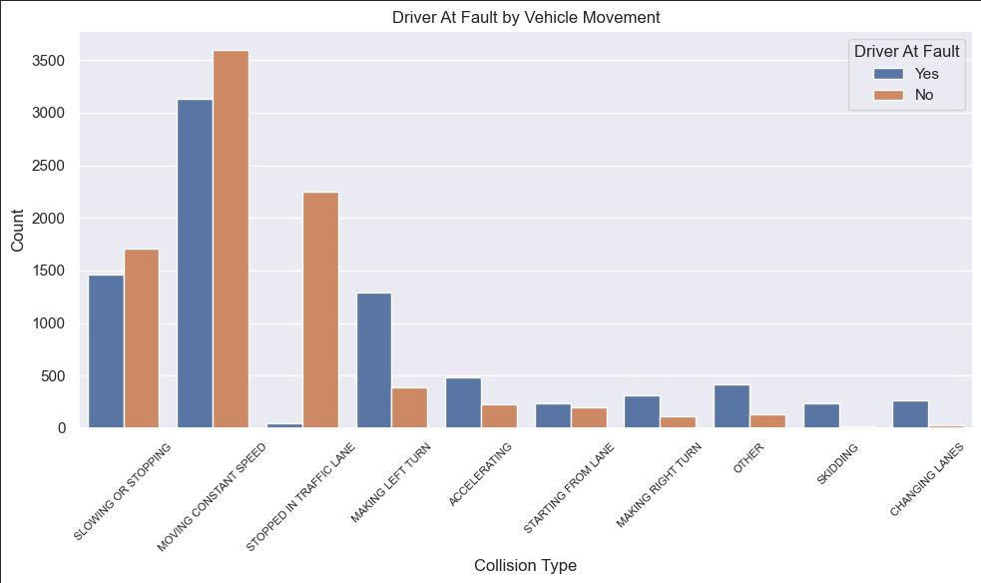
Driver at fault by vehicle movement
Moving Constant Speed & Slowing and Stopping: The two categories with the highest counts of drivers at fault.
Stopped in Traffic lane: This movement has a noticeably lower count of at-fault drivers, suggesting that vehicles not moving is less frequently associated with fault.
Other Movements: Less common movements like skidding or changing lanes also show a higher correlation with driver fault.
Notes:
The graph reveals that certain movements, particularly those involving speed changes or complex maneuvers, have a stronger link to accidents where the driver is deemed at fault.

Slide 14
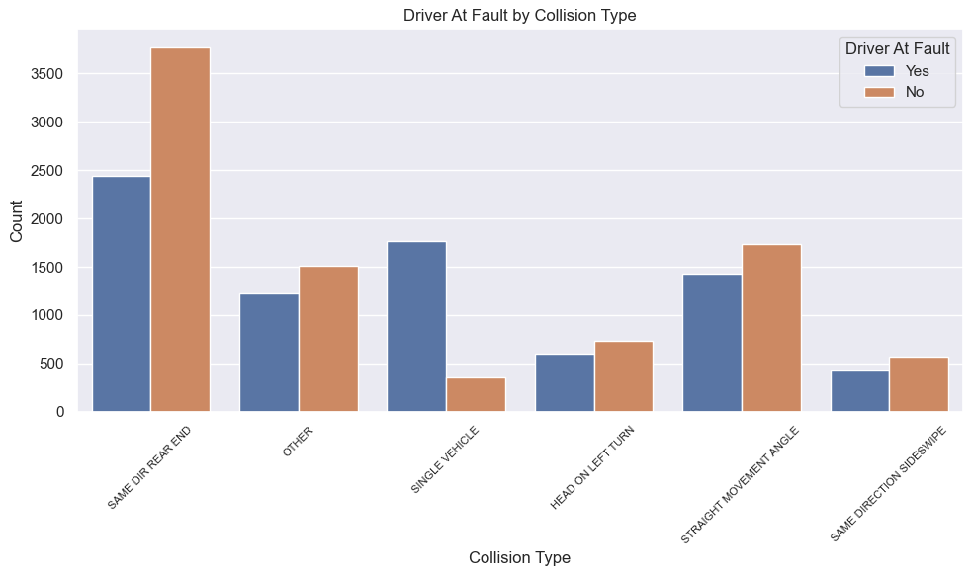
Driver at fault by collision type
Same Direction Rear-End: Exhibits the highest frequency of at-fault drivers, though this is due to the high volume of accidents
All other models excluding single vehicle: These models have similar distribution
Single Vehicle: This types show a significant number of at-fault drivers as single vehicle are the only ones in an accident
Notes:
The graph highlights the complexity of assigning fault, with rear-end collisions most commonly resulting in fault, while head-on and left-turn incidents also feature prominently.

Slide 15
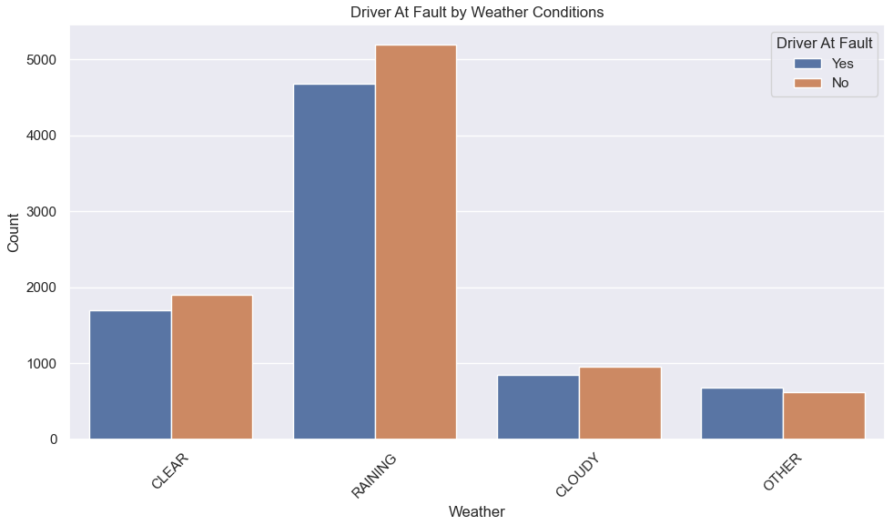
Driver at fault by weather
Raining Weather: Shows the highest number of drivers at fault, possibly due to higher traffic volumes or worsening weather conditions.
Clear and Cloudy: Have a lower count of at-fault drivers, which could indicate at fault drivers happen less during clearer weather conditions.
Other Conditions: This category has the lowest count for at-fault drivers, which might include less common weather conditions.
Notes:
The data suggests weather plays a role in driving behavior and the resulting determination of fault in accidents.

Slide 16
05
Prediction Models
Notes:
Now I will walk you through our prediction models

Slide 17
Prediction Models We Used
01
02
K-NN
Logistic Regression
03
04
Decision Tree
Random Forest
05
06
Boosting & Bagging
Neural Network
Notes:
We basically ran all the classification models we had in class, including Knn, logistic regression, decision tree, random forest, boosting and bagging. Except for these models, we also conducted a neural network model to have a more comprehensive picture of which model fits the best with our business question.

Slide 18
Grid Search CV Tuning Parameters
K-NN
Baseline number of neighbors: 5
Best number of neighbors: 6
Logistic Regression
Baseline max iter:1000
Best max iter: 100
Best penalty: 0.001
Decision Tree
Best max depth: 10
Best max features: None
Best min sample leaf: 15
Best min sample split: 2
Random Forest
Baseline n_estimators: 100
Best n_estimators: 100
Best max depth: 10
Best max features: None
Best min sample leaf: 15
Best min sample split: 2
Bagging & Boosting
Baseline n_estimators: 50
Best learning rate: 0.2
Best max depth: 3
Best n_estimators: 150
Neural Network
Baseline: (2)
Best hidden layer sizes: (2)
Best learning rate: constant
Best penalty: 0.0
Notes:
Before we jump into the model performance, we took several initiatives to improve the model performance. One crucial step we took is to use grid search cv to perform hyperparameter tuning and find out the best parameters when training each model, and we have also listed best parameters for each model here. Except for grid search CV, we also tried to bring two new features to the dataset and conducted PCA for boosting the performance further, but results turned out that these approaches are not helpful at all.

Slide 19
Models Performance Comparison
K-NN
Baseline: 78.67%
Grid Search CV: 79.48%
Logistic Regression
Baseline: 63.19%
Grid Search CV: 63.19%
Decision Tree
Baseline: 82.65%
Grid Search CV: 88.29%
Random Forest
Baseline: 87.65%
Grid Search: 88.62%
Bagging & Boosting
Bagging Baseline: 86.84%
Boosting Baseline:87.05%
Gradient Boosting GridSearch: 88.87%
Neural Network
Baseline: 68.38%
Grid Search: 68.38%
Notes:
After we tuned our models using grid search cv, these are the model performance results we got. We decided to use accuracy to evaluate our model performance as we have a pretty balanced dataset, and classes are equally distributed. From the performance score we listed here, the worst model we have is logistic regression, which the final performance is only 63% after the parameter tuning. On the other side, the best model we found is tuned gradient boosting model, in which the accuracy achieves 88.87%.

Slide 20
Best Model v.s Worst Model
Boosting
Suitable for our car crash dataset due to its ability to handle complex datasets with high dimensionality and a large number of input variables.
Logistic Regression
Non-suitable for our crash dataset due to the addition of more complexity and dimensionality from encoding our data
Makes it hard to generalize as this method is one of the simplest
Notes:
When we were digging deeper into why there is a huge performance difference between our best and worst prediction models, we found out that for boosting, it is suitable for our dataset as it has the ability to handle high dimensionality and large number of predictors we have in our cleaned dataset. However, for logistic regression, it has limited ability in capturing the complexity and dimensionality of our dataset. Besides, due to the simplicity of the mode, it makes the model hard to perform generalization, therefore leading to the worst performance eventually.

Slide 21
06
Challenges/Applications

Slide 22

Challenges
Finding Variables
Method of tuning data
Initially selected "ACRS Report Type" as target variable.
Realized choice was ill-suited for predictors.
"ACRS Report Type" lacks practical meanings for our analysis.
Chose encoding over dummy variables due to non-binary, non-integer predictors.
Advantageous: converts categories to numerical values without extra columns.
Results in concise, interpretable dataset; retains essential categorical information.

Slide 23
Use Cases
Insurance Claims
Legal Proceedings
Real World Application
Automated Fault Assessment
Speed up claims processing by automating fault determination
Fraud Detection
Enhance consistency between accident reports
Identify fraudulent claims reducing losses and ensuring fair premiums
Pre-trial Analysis
Provide preliminary fault assessments
Supporting Evidence
Outputs can serve as evidence to support client cases in court
Help demonstrate due diligence or negligence effectively

Slide 24
Thank You
Any Question?

